Slide 1
Safe Systems Programming in Rust TETRA RustIEC User Group Meeting 24/11/2022
Stijn Volckaert stijn.volckaert@kuleuven.be

Slide 3


Slide 4


Memory Unsafety in C/C++
system(“/bin/sh”)
“/bin/sh”
pointer to “/bin/sh”
pointer to system function
void greet() {
char buf[128];
printf("Type your name: ");
scanf("%s", buf);
printf("Hello %s!\n", buf);
}
int main() {
while (true)
greet();
return 0;
}
stack
return address
return address
buf

Slide 5
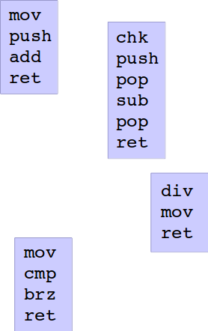
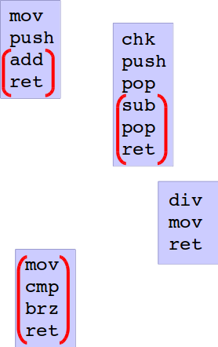

Return-Oriented Programming
pointer to gadget 3 pointer to gadget 2 pointer to gadget 1
stack
return address
buf
[*] H. Shacham. "The geometry of innocent flesh on the bone: Return-into-libc without function calls (on the x86)." ACM CCS 2007.

Slide 6
Memory Vulnerabilities
Spatial vulnerability:
(Potentially) accessing a memory location that was never valid (e.g., out-of-bounds access)
Temporal vulnerability:
(Potentially) accessing a memory location that is no longer valid (e.g., use-after-free)
char name[4096];
int main(int argc, char** argv) {
char* tmp = (char*) malloc(100);
printf("Type your name: ");
gets(tmp);
printf("Hello %s!\n", tmp);
strcpy(name, tmp);
free(tmp);
tmp[5] = 'a’;
return 0;
}
SPATIAL VULNERABILITY
TEMPORAL VULNERABILITY

Slide 7
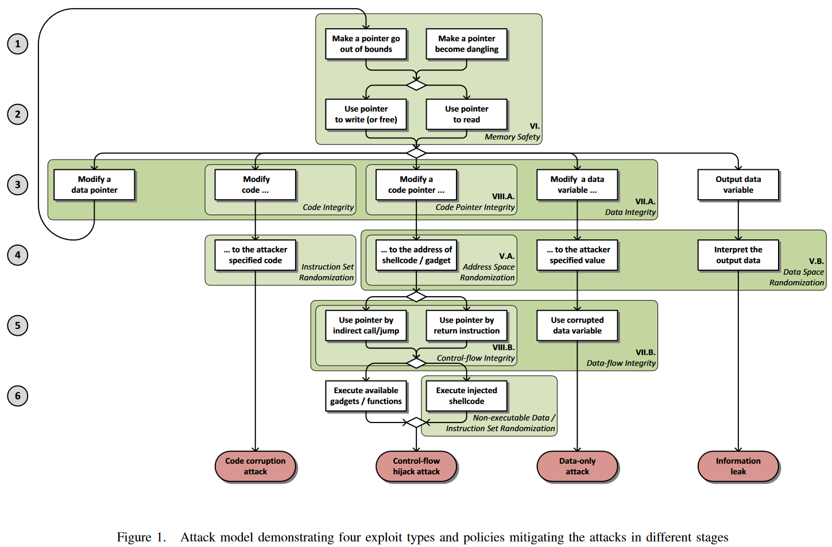
Notes:
Szekeres, L., Payer, M., Wei, T. and Song, D., 2013, May. Sok: Eternal war in memory. In 2013 IEEE Symposium on Security and Privacy (pp. 48-62). IEEE.

Slide 8


Memory Vulnerabilities
Good News: memory vulnerabilities are almost exclusive to C and C++
Bad News: C/C++ are everywhere

Slide 9















C and C++ are everywhere
Language of choice to build infrastructure:
Operating systems
Browsers
Web servers
Virtual machine monitors
Productivity software
Data base servers
Game engines
Shells
…

Slide 10
Why do people use C/C++?
Pointers & raw memory access
Simplicity and control
Inline assembly
C is “fast” and lightweight

Slide 11


Safe Systems Programming
C/C++ remain the languages of choice for system software. Until recently, no other language offered high performance, raw pointers, and inline assembly without garbage collection
Entering Rust:
Announced by Mozilla in 2010. Stable release in 2015
Now mature enough for big and complex projects:
Mozilla's Servo browser engine
Redox operating system, official support in the Linux kernel!
Dropbox, Cloudflare, Microsoft, Amazon’s internal infrastructure
… and many, many more https://prev.rust-lang.org/en-US/friends.html

Slide 12
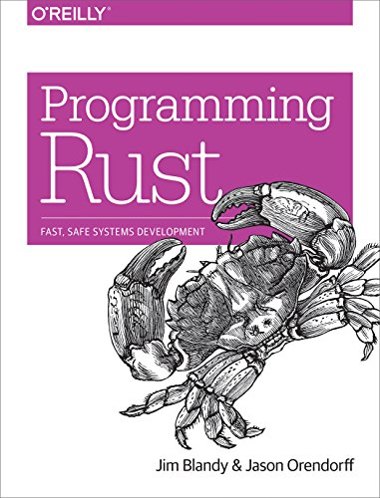
Safe Systems Programming
The Rust promise:
Full (provable) safety
No undefined behavior
Great performance
No garbage collection!
Documentation:
"The Rust Programming Language" or TRPL https://doc.rust-lang.org/book/
"Programming Rust: fast, safe systems development" Jim Blandy & Jason Orendorff O'Reilly Publishers

Slide 13
Ownership and References
How does Rust enforce thread and memory safety?

Slide 14
Introduction
Rust promises full type safety, thread safety, and memory safety:
Type safety implies you can only perform operations that are valid for a variable's type on that variable (example: you cannot call a string concatenation function on an integer in Rust)
Memory safety implies there are no temporal or spatial memory vulnerabilities
Thread safety implies there are no data races or synchronization issues
Rust achieves memory and thread safety primarily through its use of ownership, references, and borrowing

Slide 15
Ownership
if s == 5 {
// `t` is a variable of a primitive type (i32)
// primitive-typed values are allocated on
// the stack.
// `t` "owns" the value
// When t goes out of scope, it loses
// ownership of the value, and the stack
// space the value occupies is deallocated.
// In Rust-speak, we say `t` is "dropped" when
// it goes out of scope
let t = 6;
println!("t = {}", t);
}
// t is dropped here
Every value belongs to precisely one variable in Rust (or is owned by a variable in Rust-speak)
Variables can own a tree of values!
When a variable goes out of scope, any values it owns is deallocated
t
Stack
6

Slide 16
Ownership
Heap-allocated values are very similar. The s_heap variable has a stack slot that only contains a pointer to a heap value. Dropping s_heap deallocates the stack slot AND the heap value!
if s == 5 {
let s_heap = Box::new(s);
println!("s = {}", s_heap);
}
// s_heap is dropped here
s
s_heap
Stack
5
Heap
5

Slide 17
Ownership
The exact same thing happens with Vectors. The only difference is that Vectors occupy several stack slots. One of them is a Box that points to the vector's contents. The other stack slots contain the vector's capacity and length
if s == 5 {
let v: Vec<i32> = vec![1, 2, 3];
println!("v = {:?}", v);
}
// v is dropped here
s
v
Stack
5
16
3
capacity
length
Heap
1
2
3

Slide 18
Ownership: Trees
We've only looked at simple ownership relationships so far. In practice, ownership relationships form trees. The value(s) owned by a variable can own other values themselves! When the program drops v, it will deallocate all values in v's ownership tree
let mut v = Vec::new();
v.push(Box::new(1));
v.push(Box::new(2));
v.push(Box::new(3));
println!("v = {:?}", v);
s
v
Stack
5
16
3
capacity
length
Heap
1
2
3

Slide 19
Ownership: Trees
One interesting consequence of Rust's ownership mechanism is that it is not possible to construct doubly-linked lists in safe Rust code.
In a doubly-linked list, every value would be owned by two other values!
let mut v = Vec::new();
v.push(Box::new(1));
v.push(Box::new(2));
v.push(Box::new(3));
println!("v = {:?}", v);
s
v
Stack
5
16
3
capacity
length
Heap
1
2
3

Slide 20
Ownership: Moves
In most cases, assigning a variable x to variable y makes y the new owner of any values previously owned by x. Moves have interesting semantics. A move operation only moves the direct child value of the source variable. Values the original variable owned indirectly stay just where they were!
let v: Vec<i32> = vec![1, 2, 3];
println!("v = {:?}", v);
// this assignment transfers ownership
// of the vector from v to w
let w = v;
v
w
Stack
16
3
16
3
capacity
length
capacity
length
Heap
1
2
3
Notes:
Moving the direct child value does, however, make the destination variable the new owner of the entire value tree previously owned by the source variable!

Slide 21
Ownership: Safety
fn print_vec(m: Vec<i32>) {
println!("m = {:?}", m);
} fn main() {
let mut v = vec![1,2,3,4];
// this call transfers ownership of the
// vector from v to print_vec's m argument
print_vec(v);
v[0] = 2;
}
Rust’s use of ownership eliminates all temporal memory vulnerabilities and does NOT require garbage collection!
Compiling tst v0.1.0 (C:\Users\stijn\Desktop\tst)
error[E0382]: borrow of moved value: `v`
--> src\main.rs:10:5
|
9 | print_vec(v);
| - value moved here
10 | v[0] = 2;
| ^ value borrowed here after move
|
= note: move occurs because `v` has type `std::vec::Vec<i32>`, which does not implement the `Copy` trait

Slide 22
Ownership: Moves
There are three ways to prevent automatic transfer of ownership:
3. We can temporarily borrow a source variable
fn print_vec(v: &Vec<i32>) {
println!("v = {:?}", v);
} fn main() {
let mut v = vec![1, 2, 3];
print_vec(&v);
// this is ok. `print_vec` only "borrowed" `v`. The borrow
// automatically ended when `print_vec` returned
// This means that `v` is still the owner of the vector, so
// we can still modify `v`!
v[0] = 4;
}

Slide 23
Ownership: References and Borrowing
The & operator creates a reference to a variable. A reference always has a reference type, which behaves almost exactly like the non-reference type but has a different notation. Example: i32 is a non-reference type. &i32 is a reference type. To create a mutable reference, use &mut instead of &. Example:
let mut v: Vec<i32> = vec![1,2,3];
// x "borrows" the vector value owned by v
let x: &mut Vec<i32> = &mut v;
// Although x has a reference type, it supports all // of the methods we can call on the non-reference // type! This is because Rust automatically // dereferences variables when call a method on them
x[0] = 4;

Slide 24
Ownership: References and Borrowing
A borrow ends when the reference variable is dropped (i.e., when it goes out of scope). Example:
fn print_vec(x: &Vec<i32>) {
println!("x = {:?}", x);
// print_vec returns here. This means `x` goes
// out of scope and is dropped.
// Dropping `x` means the borrow of the value
// owned by variable `v` ends here
} fn main() {
let v: Vec<i32> = vec![1,2,3];
// The `x` argument of `print_vec` borrows
// the value owned by `v`
print_vec(&v);
}

Slide 25

Ownership: References and Borrowing
Rules for borrowing:
Rust enforces the multiple readers or single writer rule for references. This means you can either create any number of immutable references to the same variable or you can create one single mutable reference to a variable. You can NOT simultaneously have immutable and mutable references to the same variable.
You can NOT access the original variable while it is borrowed.
You can NOT create a mutable reference to an immutable variable.
You CAN create an immutable reference to a mutable variable.
You MUST initialize all references to a valid non-zero value.

Slide 26


Ownership: References and Borrowing
let mut v = vec![1,2,3];
// this is fine
let w = &v;
// this is also fine. we can have as many
// immutable borrows as we want
let x = &v;
// this is NOT fine. you cannot have
// mutable and immutable borrows at the
// same time
let y = &mut v;
// this is NOT fine either. You cannot
// use the original variable while
// it is borrowed
v = vec![5,6,7];
// this is NOT fine either. References MUST
// be initialized to a valid non-zero value
let z: &Vec<i32>;

Slide 27
Ownership: References and Borrowing
What is the point of this borrowing mechanism?
Thread Safety! The multiple readers or single writer rule eliminates all data races. Data races only happen if a variable is mutated while it can be read from another thread. Rust's borrowing mechanism does not allow simultaneous mutation and sharing.
Speed! The compiler knows when a variable can be mutated and when it cannot. If the compiler is 100% certain that a variable cannot be mutated, it can generate much faster code by eliminating unnecessary memory accesses.

Slide 28
Rust's Safety Guarantees

Slide 29
Rust's Safety Promises
Rust promises three types of safety that C and C++ cannot provide:
Type safety implies you can only perform operations that are valid for a variable's type on that variable (example: you cannot call a string concatenation function on an integer in Rust)
Memory safety implies there are no temporal or spatial memory vulnerabilities
Thread safety implies there are no data races or synchronization issues

Slide 30

Type Safety
In C/C++, type safety can be violated in two ways:
The program uses an invalid cast to convert a pointer to an incompatible type. This is particularly dangerous in C++ programs where most objects contain virtual function tables and can lead to type confusion attacks. C and C++ explicitly permit invalid casts, but Rust does not!
The program has a spatial or temporal memory error that causes a pointer to point to an object of the wrong type. Rust prevents these errors through its use of ownership, references, borrowing, and bounds checking.
Notes:
For an example of a type confusion attack, see: https://www.usenix.org/system/files/conference/usenixsecurity15/sec15-paper-lee.pdf

Slide 31

Memory Safety
Spatial memory errors occur when the program dereferences an out-of-bounds pointer or reference. Rust prevents such errors by:
Not allowing raw pointers or pointer arithmetic in safe code
Requiring that references are always initialized to a valid value (borrow checker)
Performing bounds checks for accesses to arrays or dynamically-sized containers (e.g., vectors). Thanks to these bounds checks, overflow errors cannot occur.

Slide 32

Memory Safety
Temporal memory errors occur when the program dereferences a dangling pointer or reference, or accesses uninitialized memory. Rust prevents these errors by:
Tracking ownership of all values. When a variable goes out of scope, all the values the variable owns are deallocated, and the variable can no longer be used.
Tracking lifetimes of all references. A reference can never outlive the values it points to.
Requiring that all variables are initialized before the program uses them.

Slide 33

Thread Safety
Thread Safety is violated when the program allows data races. Data races can occur when one thread writes data while another thread can read that data. Rust prevents these errors by enforcing the multiple readers or single writer rule. Thanks to Rust's borrowing mechanism, no data can ever be simultaneously readable by one thread and writable by another.

Slide 34
Bending the rules
Sometimes, you have to write unsafe code

Slide 35





Introduction
There are certain cases where we have to write unsafe code that violates at least one of Rust’s safety checks. In Rust, there are four unsafe superpowers:
Dereferencing a raw pointer
Calling an unsafe function or method
Accessing or modifying a mutable static variable
Implementing an unsafe trait

Slide 36
Raw pointers
Rust normally ensures that references are always valid. This is primarily done through lifetime tracking. In some cases (e.g., when we want to communicate with a hardware device through Direct Memory Access), we need references that cannot be checked statically. Rust implements unchecked references through raw pointers.
A raw pointer can:
Ignore the multiple readers or single writer rule. There can be multiple writers and there can be readers and writers at the same time!
Point to invalid memory. Rust does not know about DMA mappings so the compiler cannot know if/when a DMA region is valid.
Be null
Live forever without being dropped

Slide 37

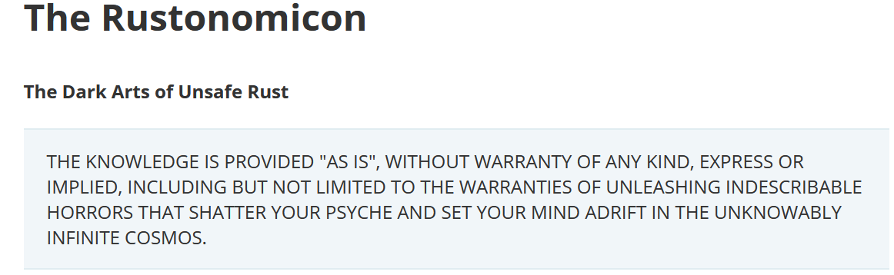
The Rustonomicon
https://doc.rust-lang.org/stable/nomicon/

Slide 38
Migrating to Rust

Slide 39

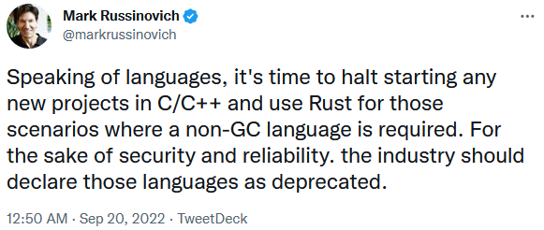
New Projects

Slide 40
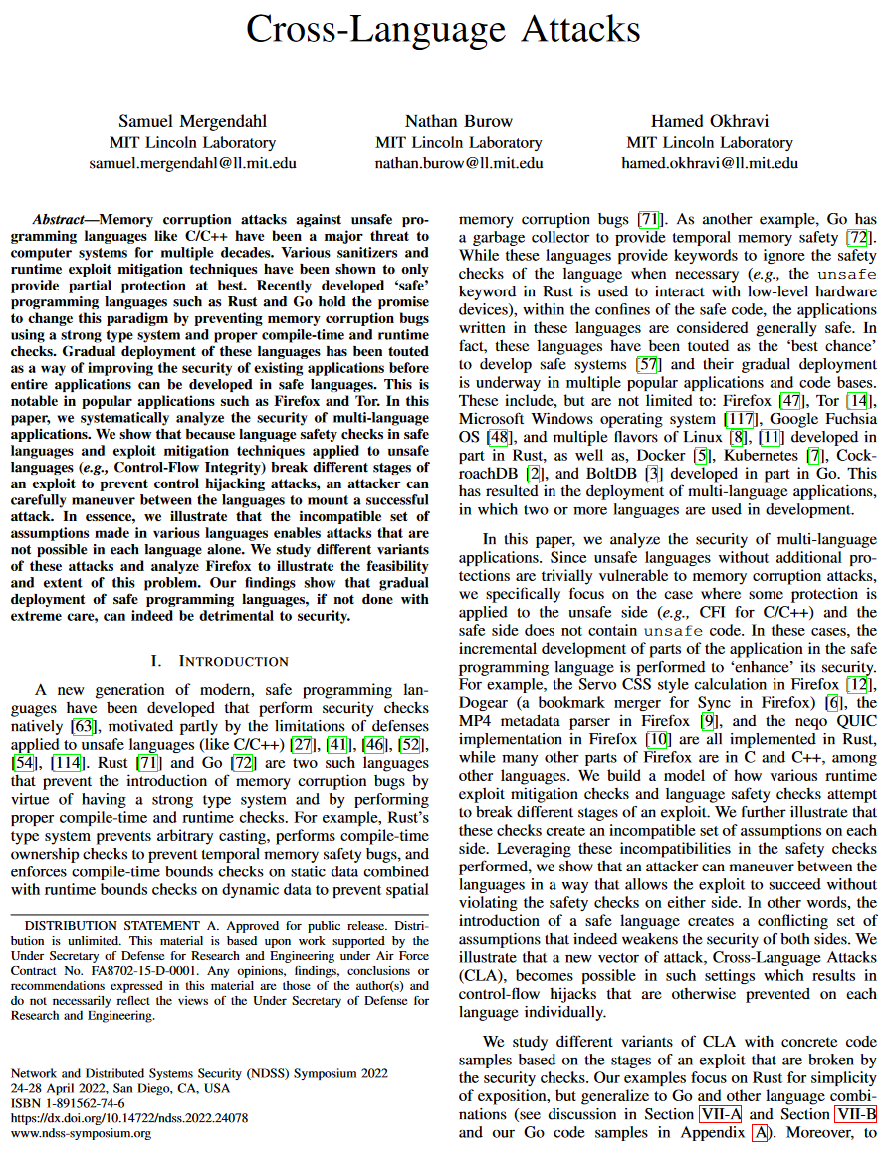
Existing Projects
Gradual migration is possible!
Interoperability:
https://github.com/rust-lang/rust-bindgen
https://github.com/eqrion/cbindgen
https://firefox-source-docs.mozilla.org/writing-rust-code/cpp-interop.html
Transcoding:
https://c2rust.com/
Best practices
Cross-language safety

Slide 41


